Slide 1
DARPA TRADES Challenge Problems Overview
Jan Vandenbrande, Ph.D.
Program Manager, Defense Sciences Office
Defense Advanced Research Projects Agency
6/3/2020
Distribution Statement “A” (Approved for Public Release, Distribution Unlimited)

Slide 2
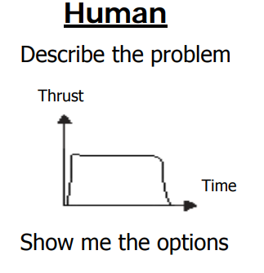
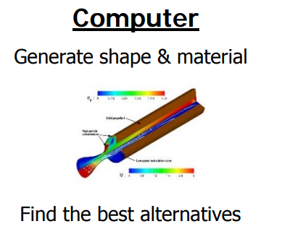
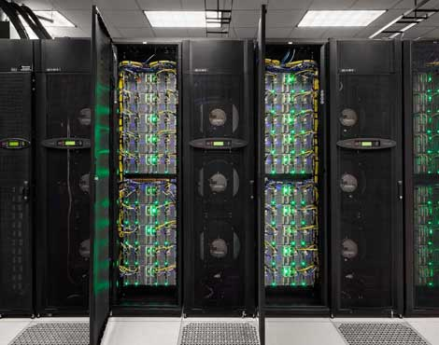
Transformative Design (TRADES) Program Goal
Objective: Develop and exploit new mathematics and algorithms to incorporate advanced materials and manufacturing in design
Model
Requirements
Analyze
Synthesize
HPC
TRADES
Explore: make computers a collaborative partner to enhance human designers to synthesize designs
Empower designers to explore new performance envelopes and synthesize designs unimagined today
Distribution Statement “A” (Approved for Public Release, Distribution Unlimited)

Slide 3
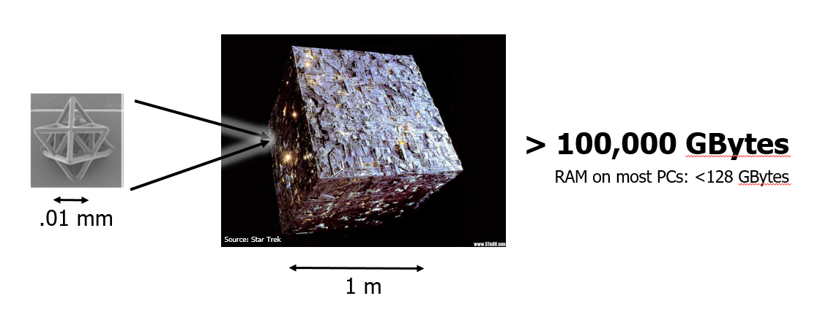
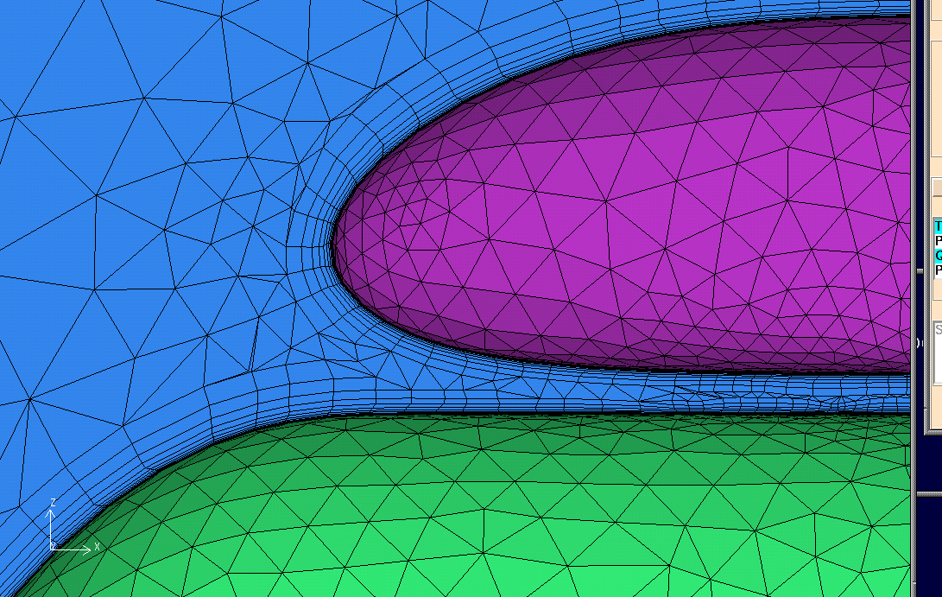
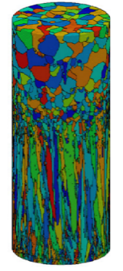
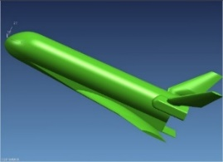
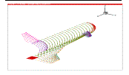
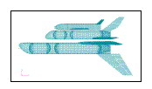
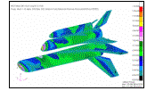
SOA limitations & challenges
SOA Design Process: Test and iterate
Modeling
Analysis
Synthesis
Geometric & Material
Model
Triangles
>50% of total human effort
Aero
How would you compensate for this?
How would you take advantage of this?
How do you deal with uncertainty?
Geodesics
Heating
Even within the same print, the material structure changes due to thermal history
Conversion
Tetrahedra
Loads
Boundary Representation
Faces
Radar
And many more
Iterate design based on results
Challenge: Current computational methods cannot represent shape and material at relevant scales and levels of complexity
Challenge: Limited interoperability between design and analysis systems prevents automated design exploration
Challenge: Inability to effectively trade material architectures and properties with shaping limits ultimate performance
Distribution Statement “A” (Approved for Public Release, Distribution Unlimited)

Slide 4
Intent of design challenges
Measure progress, feasibility and limitations of approach against metrics
Provide domain context
Challenges will exercise:
  Representation, computation and synthesis (depending on the project)
  Scale ranges: > 10⁶, micro-material architectures (~.01 mm) & macro shaping (>~1m – 100m) of an object
  Mix of physics
  Different domains (mechanical engineering, electrical, biomedical, etc.)
  “Additive” manufacturing processes (3D printing, composites, weaving/braiding/knitting)
Not required:
  Subtractive post processing
  Validated or certified analysis codes – stand-in codes are fine
Program Metric | State of the Art | Threshold | Objective
Usable level of detail in physical scale difference | ≤10⁵ | >10⁶ | > 10⁸
Object complexity (shape + material) | No material, 10⁵ to 10⁹ | > 10¹² | > 10¹⁵
Computational efficiency (e.g., simulating high fidelity physics) | Hours to weeks | Minutes | seconds
Multi-physics design process | Indirect with Parametric Multidisciplinary Design Optimization | Non-Parametric Sequential | Non-Parametric Coupled
Synthesis of shape and material subject to multi-physics | Does not exist | ≥ 2 Physics | > 3 Physics with uncertainty
Interoperability | Manual intervention | Automated | Direct
Usability | Experienced user (> 10 yrs) | Semi- professional | Non-professional

Slide 5


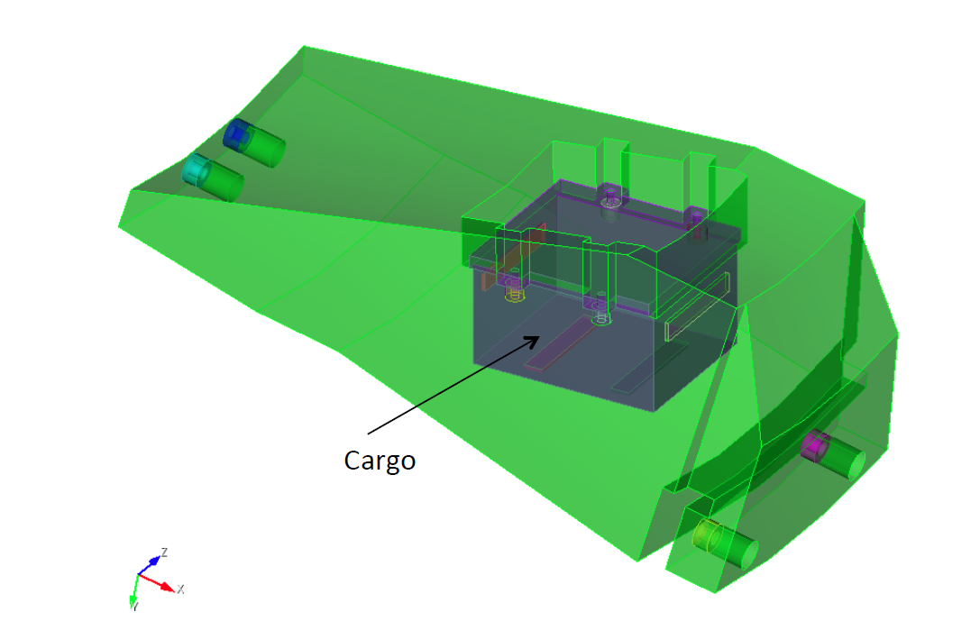
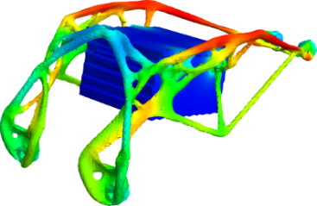
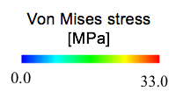
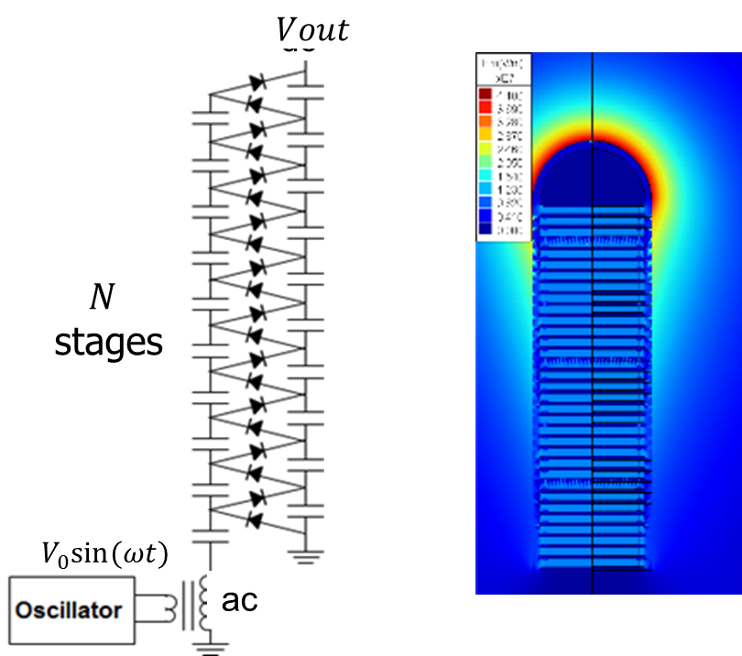
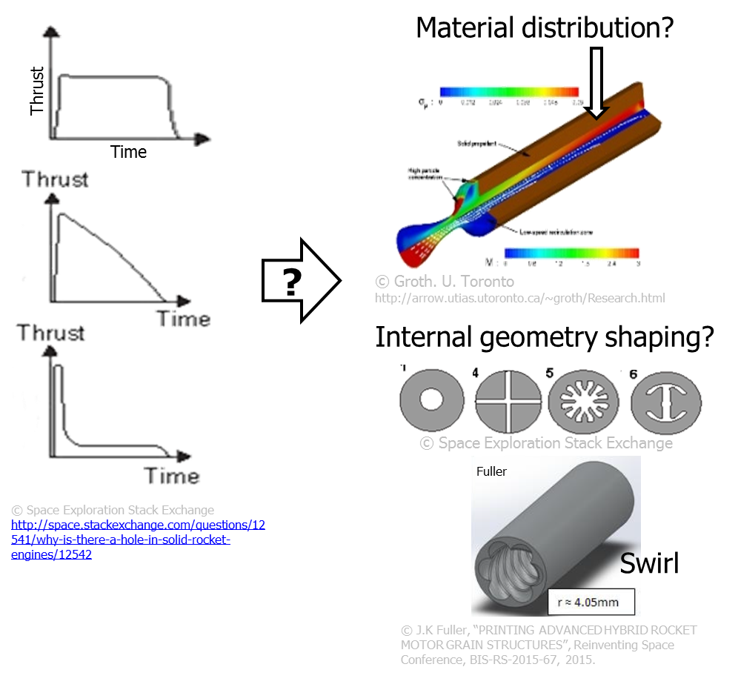
Challenge problems force generality and evaluate viability while aligning with metrics
Challenge problem set 1: Model shape & materials at scale
Released Oct. 2017
Challenge problem description
CP1A: Model across scales
CP1B: Model a femur
1A: Represent and compute integral properties of 1m³ volume with irregular connected .1mm micro truss structures
1B: Represent and compute integral properties of femur head including trabeculae
Metrics Targeted: >10⁶ scale difference & > 10¹² object complexity for representation
1 m
.01 mm
Stochastic materials
Challenge problem set 2: Balancing shaping and materials while contending with physics
Released Oct. 2017
Challenge problem description
Cargo
2A: Redesign a suspension upright swapping Ti-6Al-4V for ULTEM 9085
2B: Redesign a heat exchanger swapping AlSi10Mg for 2.0 kg EOS Stainless Steel GP1
2C: Redesign a lightweight bracket with vibration damping
design domain
Metrics targeted: Synthesis of shape and material subject to multi-physics, interoperability (automated, direct)
bolts
Challenge problem 2C: Colorado Solution to bracket redesign
Challenge problem sets 3 & 4: Designing material and shaping for multiple non-traditional physics
Released Aug. 2018
Challenge problem description
3: Design solid rocket motor with graded material properties to match various thrust profiles while avoiding casing
4: Design 4MV Volt and >.25mA DC Cockcroft Walton voltage multiplier, using a combination of shaping and graded dielectric materials to build the capacitors while minimizing volume
Metrics targeted: Synthesis of shape and material subject to multi-physics, multi-physics design process, computational efficiency (minutes)
3
4
Distribution Statement “A” (Approved for Public Release, Distribution Unlimited)

Slide 6
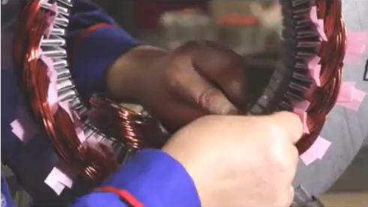
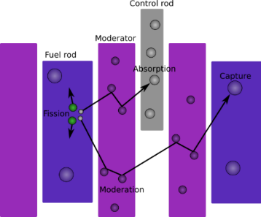
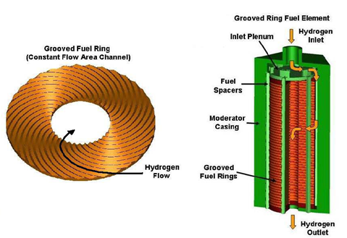
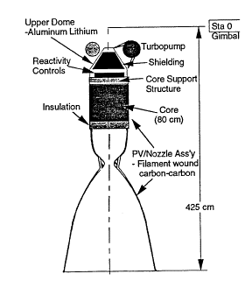
Challenge problems force generality and evaluate viability while aligning with metrics
Challenge problem sets 5 & 6: Incorporating variability and uncertainty in shaping & material
Released Oct. 2019
Challenge problem 5: Printable Electric Motor
Objective: Design a 3D printed electric motor with the optimal layout of conductors, magnetic materials and cooling ducts
Challenge: Manage variability of EM field as a result of uncertainty in shape and material
SOA manual winding of coils.
3D printed stator coils.
Neutronics
LH2 Flow Path & Heat Transfer
Thrust
Challenge problem 6: Nuclear Rocket
Objective: Design and optimize flow-path for NTR reactor to maximize thrust
Challenge: Maintain controllable fission while accommodating material variability
Metrics Targeted: Synthesis of shape and material subject to multi-physics.
Distribution Statement “A” (Approved for Public Release, Distribution Unlimited)

